Slide 1

University management system
Presented by group-D

Slide 2
Group members:
Muhammad Mansoor | DCS-2022140028
Muhammad Usman | DCS-2022140015
Ayiza Shafiq | DCS-2022140042

Slide 3
Problem statement
University management system (UMS) is a software that deals with the maintenance of university, faculty, student information within the university. UMS is an automation system, used to store the faculty, student, courses, and information of an institute. Starting from registration of a new student in the university, it maintains all the details regarding the attendance and marks of the students. The project deals with retrieval of information through an INTRANET based campus wide portal. It collects related information from all the departments of an organization and maintains files, which are used to generate reports in various forms to measure individual and overall performance of the students.
In this project, we are only targeting the development of faculty section of university management system (ums).

Slide 4
Scope of work:
Release I Selection of Functionalities | Release II Selection of User Stories | Release III Implementation of selected functionalities using C++ Programming Language. | Release IV Selection of Test cases and their implementation.

Slide 5
Roles and responsibilities:
Functionality | Sub-Functionalities
Faculty’s Profile | Faculty Details. Experience. Publications. Qualification.
Course Material | Course Packs Books Handouts etc.
Student Attendance | Attendance Report. Previous Attendance. Class Attendance.

Slide 6
Roles and responsibilities (Cont):
Functionality | Sub-Functionalities
Faculty Attendance | Attendance Report. Check in time and date. Checkout time and date. Leaves.
Assessment | Quiz. Assignment. Project. Mid-Term. Final Term.
Announcement | Notice. Upcoming Event. Add Announcement.

Slide 7
Roles and responsibilities (cont):
Functionality | Sub-Functionalities
Course Management | Academic Calendars class activities, Web Resources Assign grade points
Faculty Self Evaluation | Research & Scholarships. Teaching. Committee’s and other activities.
Faculty’s Timetable | Timetable.
Faculty Rating | Rating of Faculty by students out of 5 Stars.

Slide 8

User Stories:
Story ID | As | Wants to | So that they can
UT-01 | Faculty | update the course packs. | upload the latest deliverable content, books, and handouts for the students of their enrolled classes.
UT-02 | Faculty | upload assignment. | set the deadlines, grade assignments, check which student uploaded the assignment late and which did not upload. Also grade the assignments
UT-03 | Faculty | view the attendance report of all their courses. | check which student is having short attendance issues.
UT-04 | Faculty | access the previous attendance of students. | make corrections if needed.

Slide 9
Story ID | As | Wants to | So that they can
UT-05 | Faculty | add new attendance of each lecture to their corresponding courses. | maintain/add attendance of the physically present students
UT-06 | Faculty | add announcements | notify the students about quizzes and projects.
UT-07 | Faculty | view upcoming events | get information about the conferences, seminars, and events to be organized at the university.
UT-08 | Faculty | view notices | to get information about instructions from higher management.
UT-09 | Faculty | view their attendance. | check their monthly attendance report, check-in, checkout time and leaves status.
UT-10 | Faculty | course management section | view class activities, academic calendars

Slide 10
Story ID | As | Wants to | So that they can
UT-11 | Faculty | access grade points section | assign weightages to quiz, assignments, midterm, final term, and projects etc.
UT-12 | Faculty | view their timetable | they can keep a check on their daily schedule.
UT-13 | Faculty | view their details | make the allowed corrections or upgradations. Moreover, they will get an idea to contact the respected department for further action.
UT-14 | Faculty | view the publications section | make the allowed corrections or upgradations. Moreover, they will get a hint to contact the respected department for further action.
UT-15 | Faculty | view their overall rating | assess their teaching methodologies and bring improvements.

Slide 11
Story ID | As | Wants to | So that they can
UT-16 | Faculty | view scholarships | apply for the scholarships of their interests
UT-17 | Faculty | view the activities of committees | participate according to their interest.
UT-18 | Faculty | to provide the record of thesis supervisions | the higher management can easily view the status
UT-19 | Faculty | access the quiz section | upload the quiz problems and then update/upload their marks according to the student performance.
UT-20 | Faculty | access the projects section | upload the project statements, their deadlines and then update/upload their marks according to the student performance.

Slide 12

Story ID | As | Wants to | So that they can
UT-21 | Faculty | access the mid-term section | upload the marks according to the student performance.
UT-22 | Faculty | access the Final-term section | upload the marks according to the student performance.

Slide 13
Implemented functionalities:
Login
Dashboard
Course material
Course management
Faculty profile

Slide 14
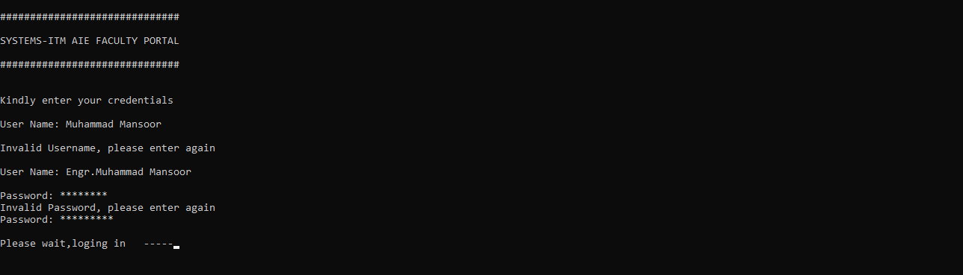
LOGIN SCREEN:

Slide 15
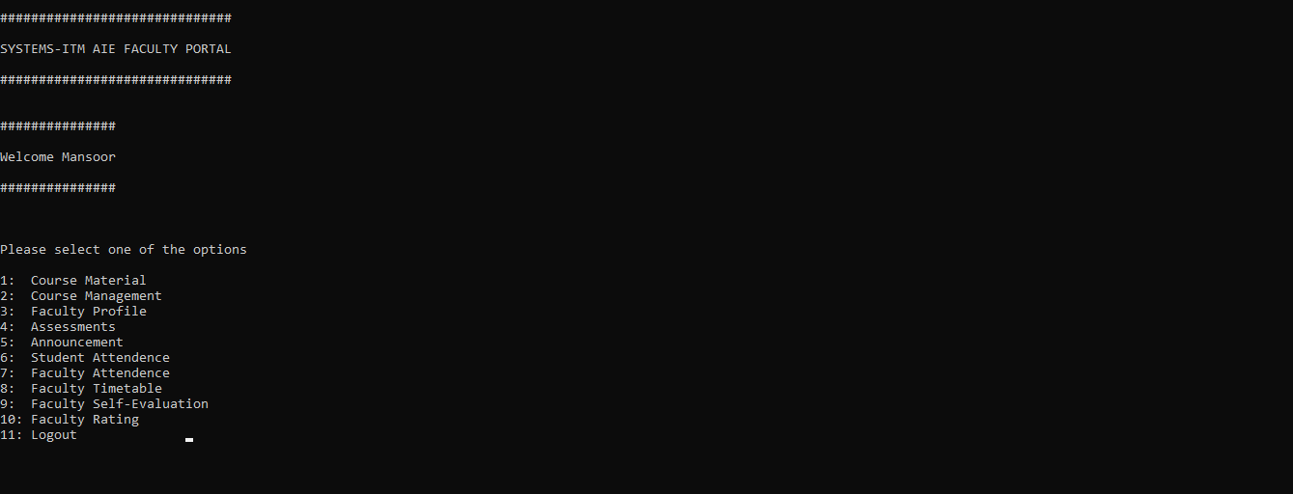
DASHBOARD

Slide 16
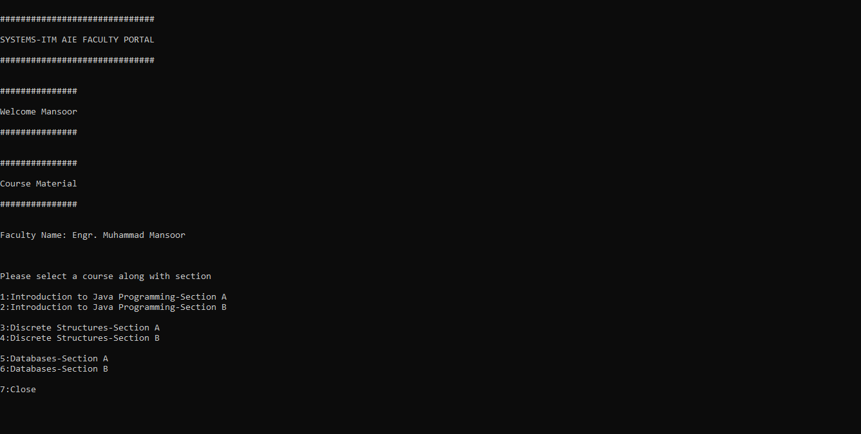
COURSE MATERIAL:

Slide 17
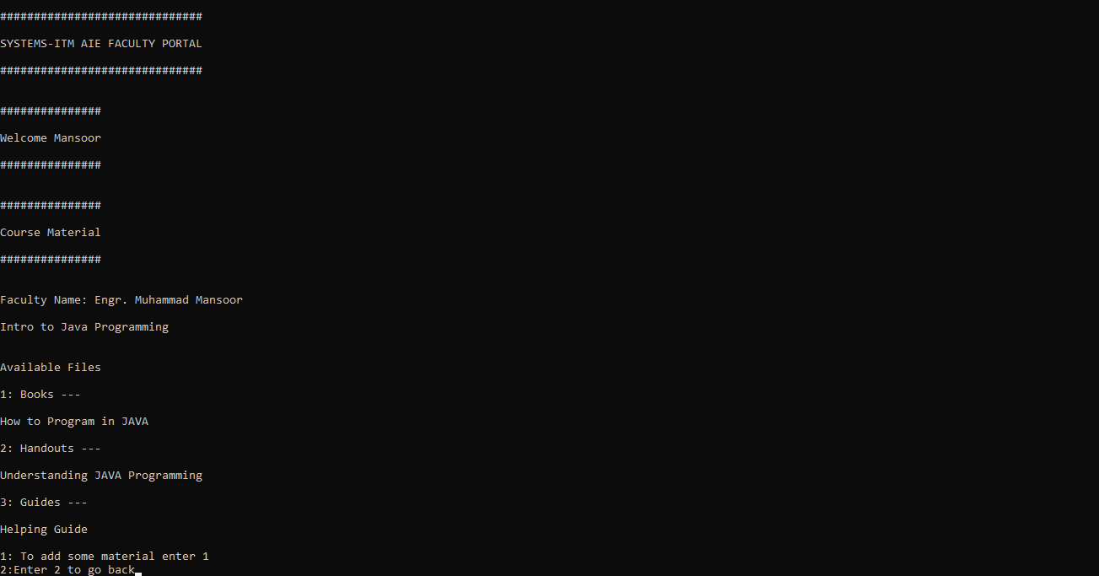
COURSE MATERIAL(CONT):

Slide 18
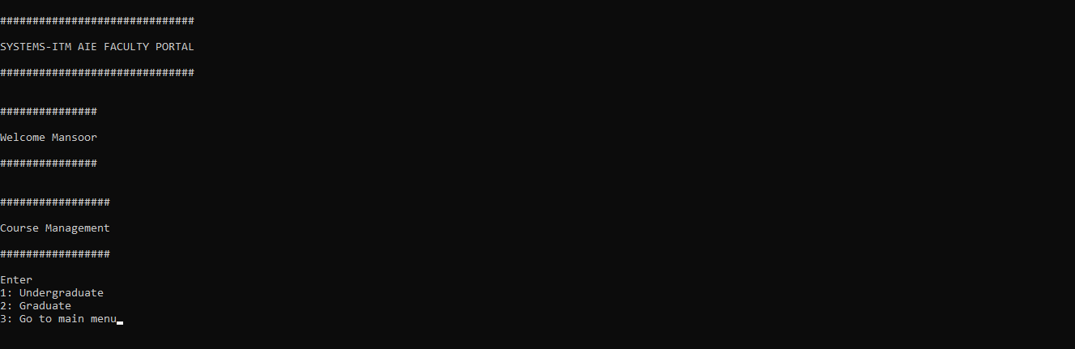
Course management:

Slide 19
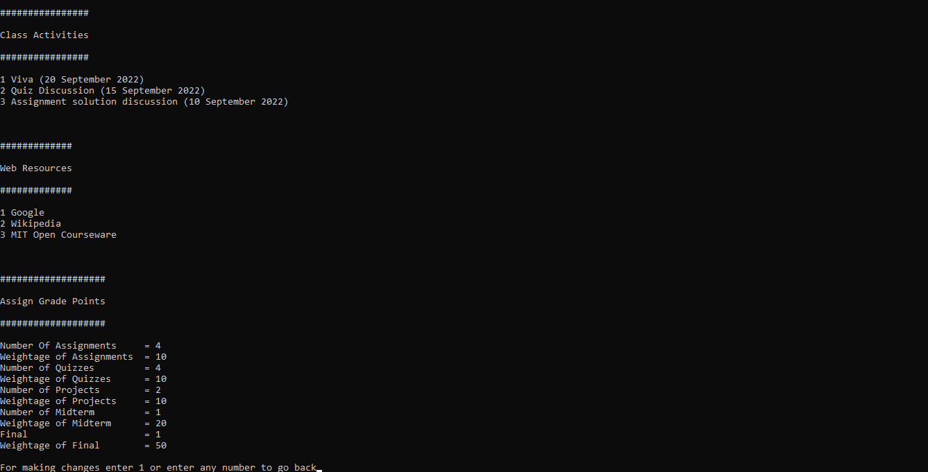
Course management (cont):

Slide 20
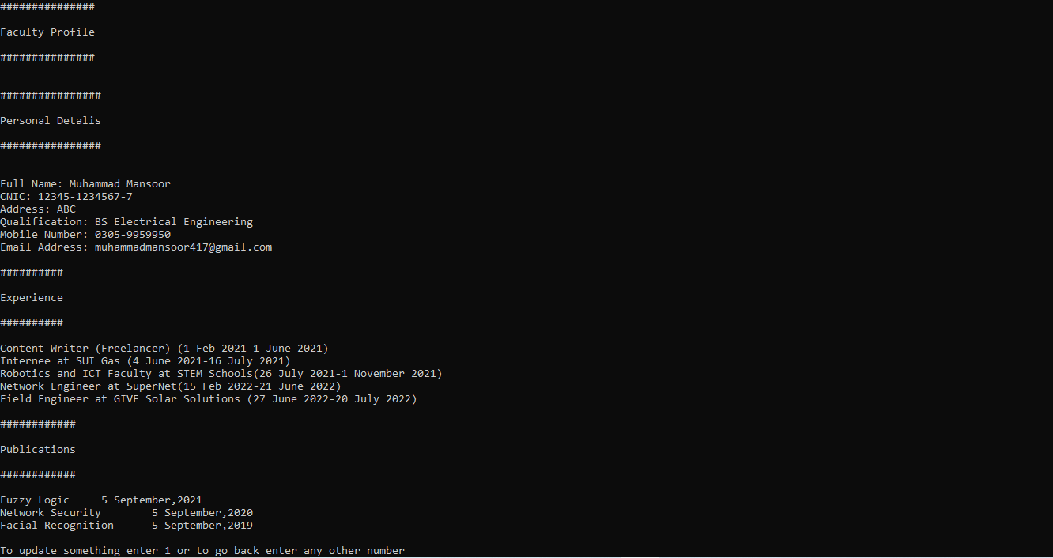
Faculty profile

Slide 21
use cases:
Add a Web Resource.
Add a book to a specific subject.
To edit and update personal info of faculty.

Slide 22
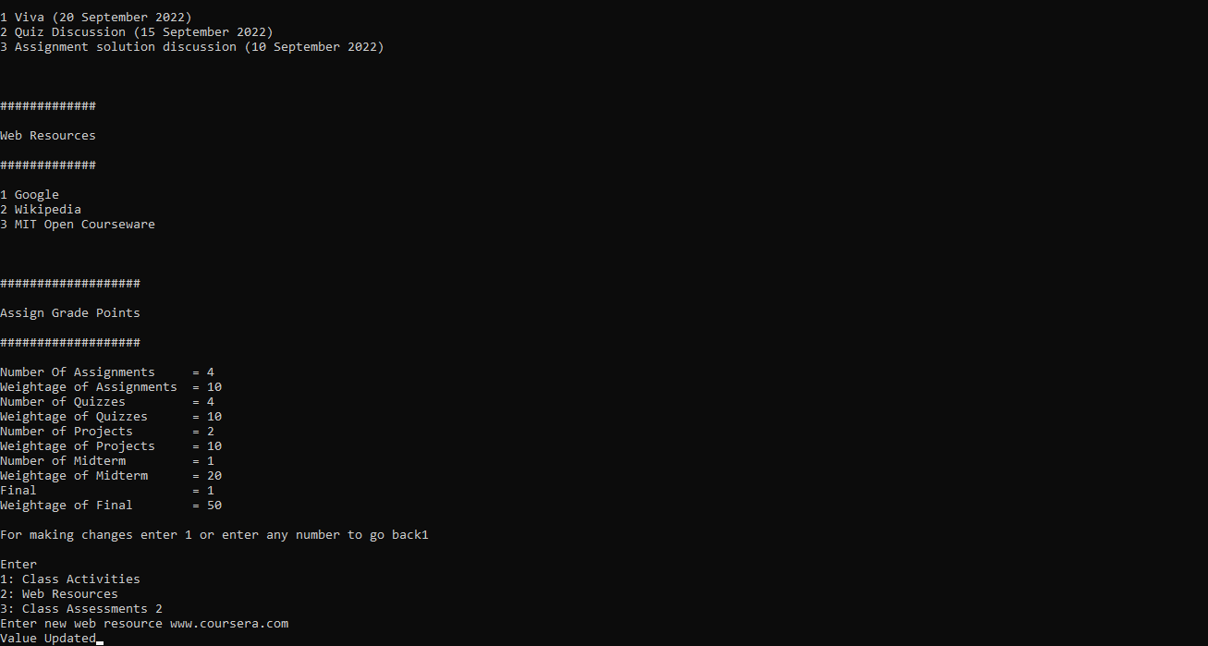
Add a web resource:

Slide 23
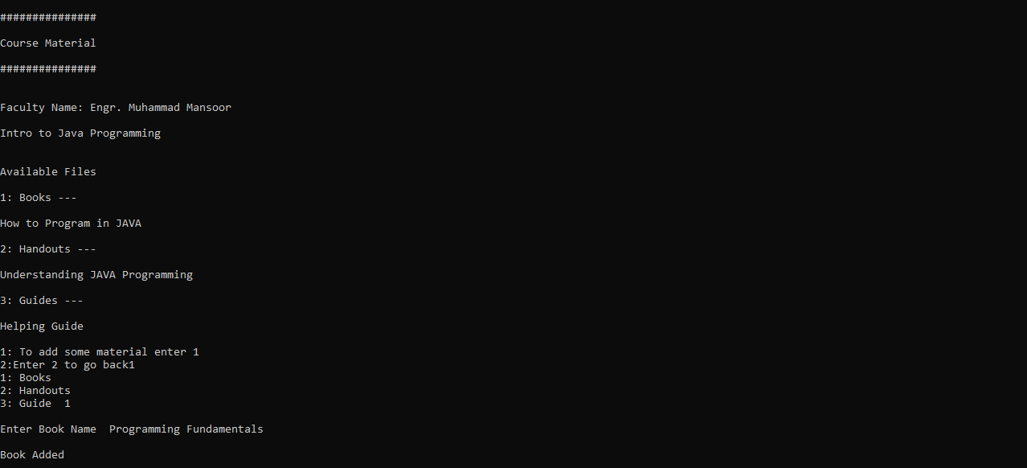
Add a book:

Slide 24
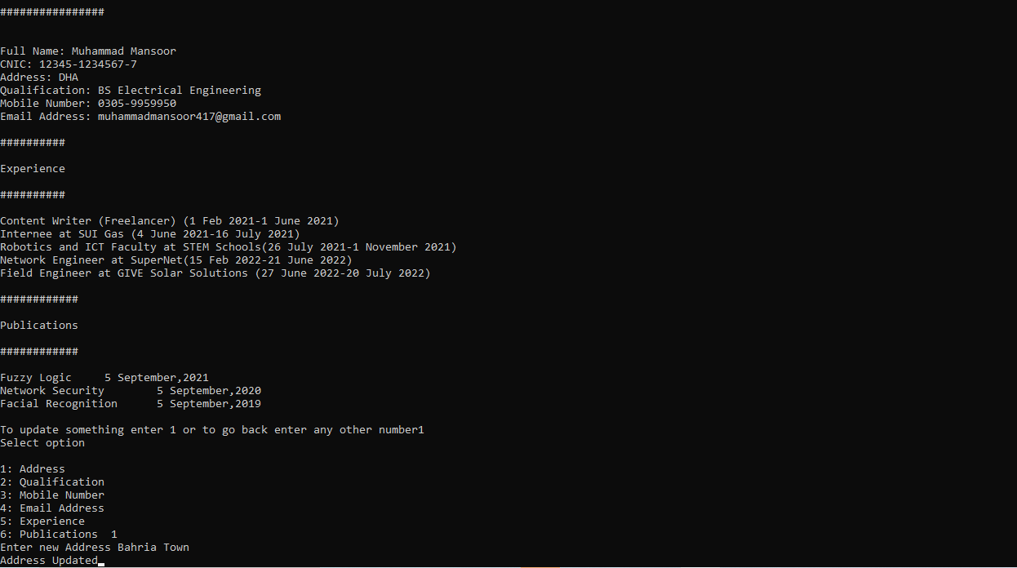
TO EDIT AND UPDATE PERSONAL INFO OF FACULTY:

Slide 25
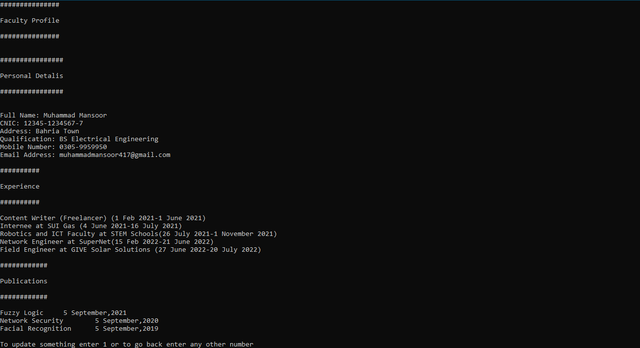
After Upgradation:

Slide 26
Out of scope:
Announcement
Assessments
Student Attendance
Faculty Attendance
Faculty Timetable
Faculty Self Evaluation
Faculty Rating
Student and administration section of UMS
Mobile app and web portal is out of scope of the project.

Slide 27
Future Work
All the out of scope functionalities.

Slide 28


Slide 29
THANK YOU

